Slide 1
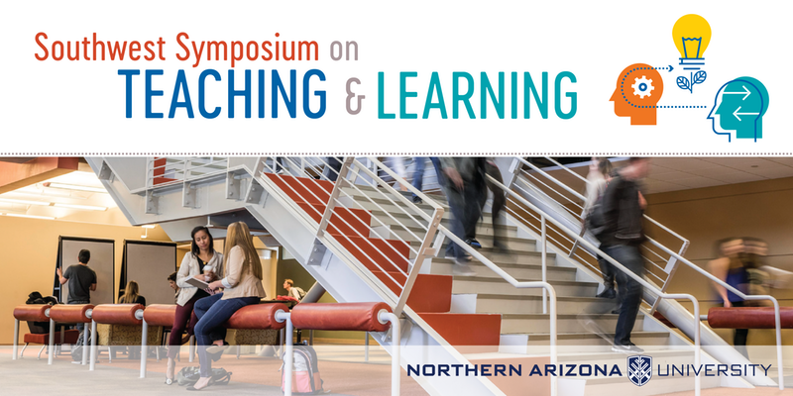

Slide 2
In the Beginning…
The Past, Present and Future of Distance Learning at NAU
Larry MacPhee
e-Learning Center

Slide 3
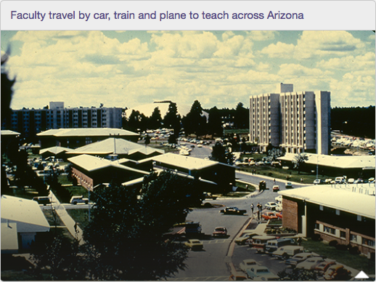
1970s
&
1980s
Teaching @ Statewide Sites: Planes, Trains and Automobiles

Slide 4
Face-to-Face Instruction at Statewide Sites
Pros:
Serves rural community
Good courses
Grows NAU enrollment
Cons:
Instructor travel needed
Expensive

Slide 5
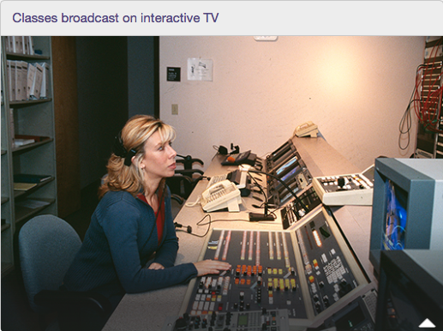
Early
1990s
Remote Instruction via Interactive Television

Slide 6
Interactive Instructional Television (IITV)
Pros:
Serves rural community
Good courses
Grows NAU enrollment
No Instructor travel needed
Cons:
Lots of technical support
Expensive

Slide 7
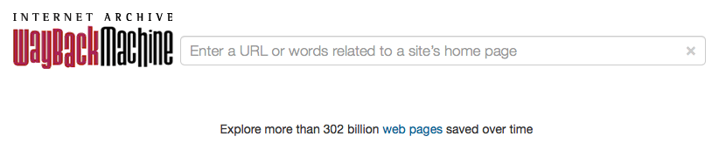
http://web.archive.org

Slide 8
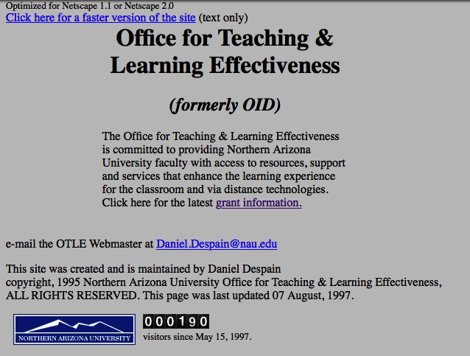
1997
Late 1990s: Early Web Courses

Slide 9
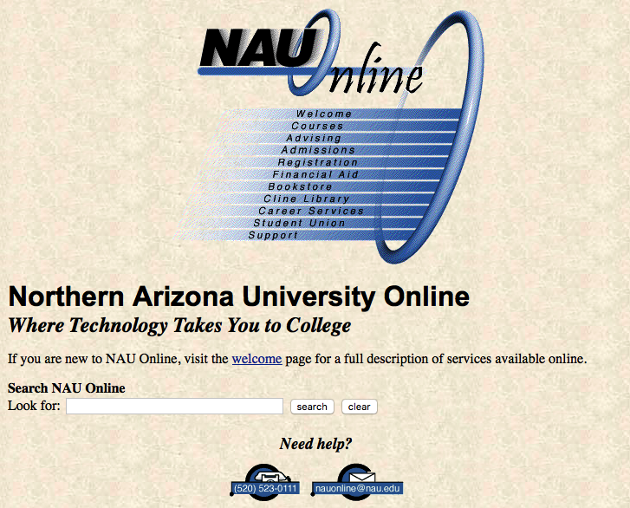
1997
Web Wizard and the VCC
Notes:
Web Wizard was a home-grown text to HTML converter. VCC was the virtual conference center, a simple discussion board tool.

Slide 10
OTLE Web Courses: Dry Cleaning Model
Pros:
Cost Effective
Good looking courses
Built lean in HTML
Ideal for dialup era
Cons:
Low Volume (Dozens)
Not Scalable
Faculty can’t modify content
Static: Minimal Interaction

Slide 11
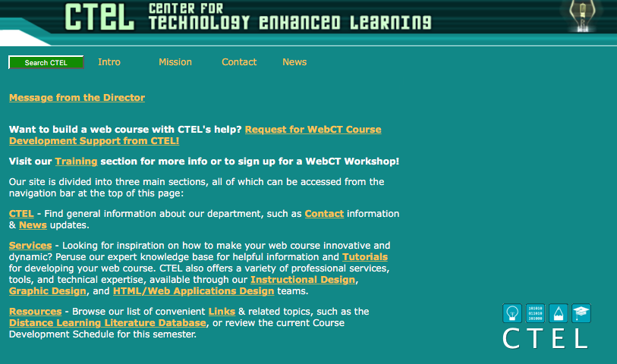
2001
CTEL was formed to increase capacity of online course support
Notes:
Merger of OTLE and EMIL (Electronic Media Integration Lab)

Slide 12

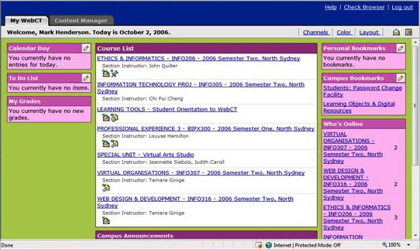
2001
Early LMS: WebCT Standard & Campus Edition

Slide 13
WebCT: Teach Them to Fish (but bait the hook)
Pros:
More Scalable
Interaction Tools
Faculty Can Modify*
SME + PM Collaboration
Cons:
Clunky Interface
Design in HTML
Heavy Support Load
Long Production Process

Slide 14
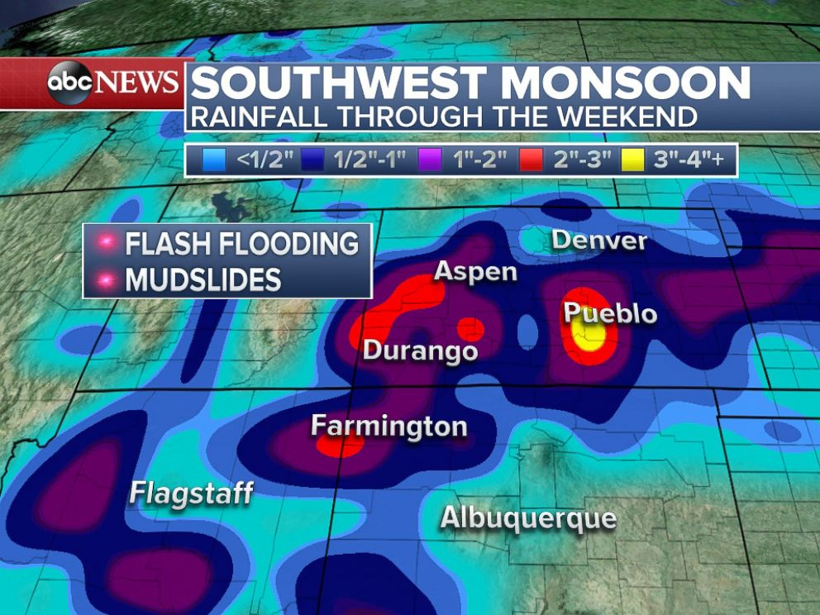
2004
Monsoons, Flooding, Power Outages, Data Corruption, Backup Problems
6-day LMS outage during Summer Sessions!

Slide 15

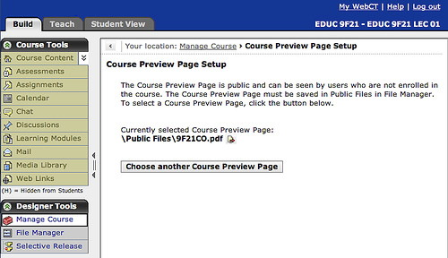
2005
Stable, load balancing, database back end, Enterprise level product!

Slide 16
Vista: Teach Them to Fish (but it’s fly fishing!)
Pros:
More Scalable
Better Interaction
Faculty can modify
Better Interface
Stable under load
Cons:
Migration (~600 courses) painful
Faculty must use DreamWeaver
Still too easy to break
Still too hard to use

Slide 17
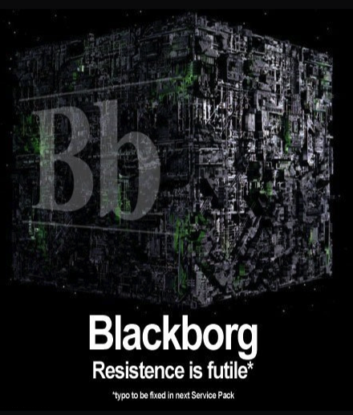
2005
Blackboard buys WebCT!

Slide 18
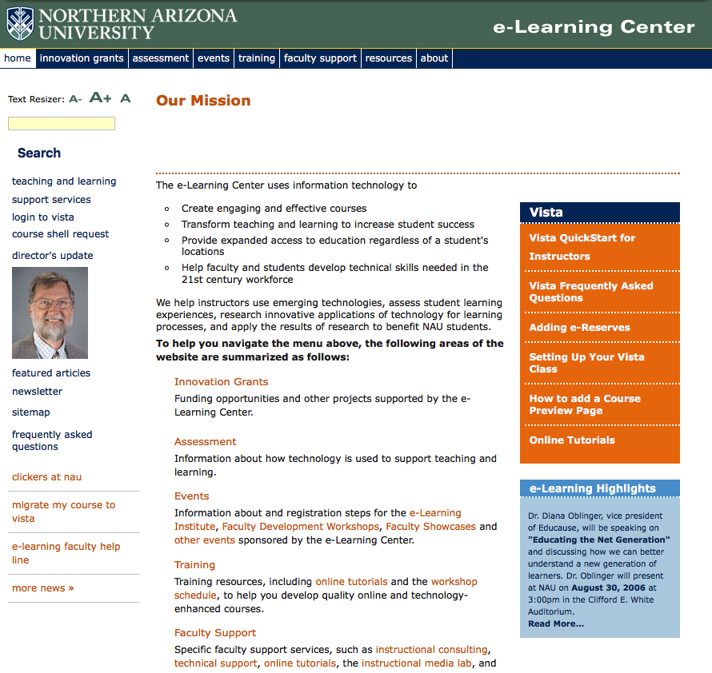
2006
CTEL and CRADLEE join to form e-Learning

Slide 19
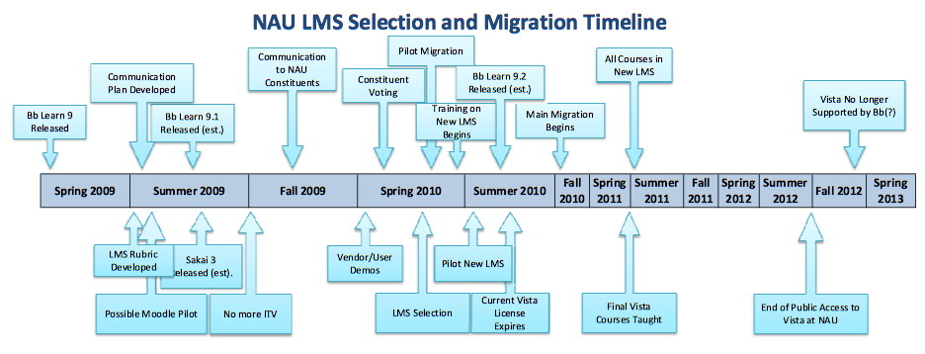
2009 - 2013
Many hundreds of courses, complex transition planning

Slide 20
“The LMS is like death by 1000 paper cuts.”

Slide 21
Gradual Automation and Enhancement
Grade Upload to SIS (LOUIE)
Shell for Every Course
Automation requires “business rules”
  Co-convened Courses
  Course Deletion
  Course Transfer
  Incompletes
  Record Retention
Boring, hard work, but important!

Slide 22
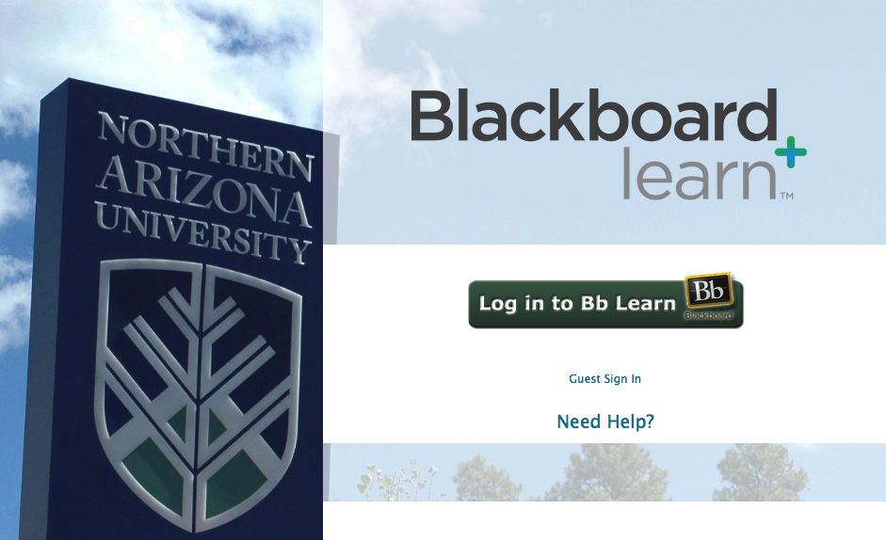
2011

Slide 23
Blackboard: Teach Them to Fish (with dynamite!)
Pros:
Easy to Learn
More Scalable
Faculty can modify
Stable under load
Cons:
Still clunky
Course migration bugs
Too easy to adopt bad pedagogy

Slide 24
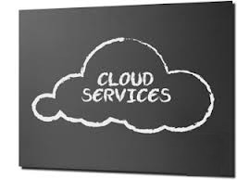
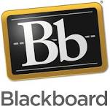
2014
Locally Hosted
Smooth transition from local servers to web-hosted

Slide 25
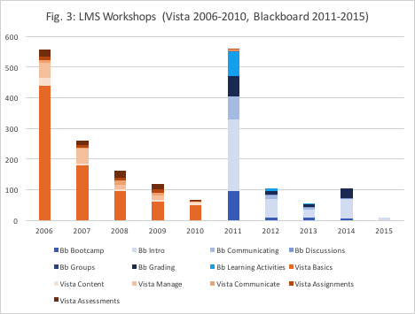
2015
LMS Training spikes after each transition

Slide 26
LMS Trends
 | OTLE | CTEL | CTEL-->ELC | ELC
Delivery System | HTML | WebCT | Vista | Blackboard
Effort | Herculean | Brutal | Strenuous | Easy
Interaction | Rudimentary | Minimal | Substantial | Substantial
Quality | High | High | Intermediate | Varies (DIY)
Quantity | Dozens | A Few Hundred | Many Hundred | Thousands
Training | Not Attempted | Intensive | Moderate | Minimal
Support | Heavy | Intermediate | Intermediate | Light

Slide 27
Changing Role for e-Learning
Support
Reduced need for LMS training
Reduced technical design assistance
Increased help desk calls
Increased support for hybrid and F2F
More teaching technologies supported
Clickers
Google Apps
Collaborate
Kaltura
Shift toward pedagogy
Academic Integrity
Group Work
Rubrics
Peer Assessment
Lecture Alternatives

Slide 28
LMS Trends II
 | 1990s | 2000s | 2010s
Course Mode | Fully Online | Fully Online Hybrid/Blended | Fully Online Hybrid/Blended Web-Enhanced In Class Exams
Content Type | Home grown | Home grown Publisher built | Home grown Publisher built* Adaptive*

Slide 29
macmillan
Pearson
Adaptive
Wiley
OpenStax
Cengage
McGraw-Hill
More and more content lives outside the LMS

Slide 30
2021: TRIF Funding?
LMS Innovation?
Blackboard Ultra?
Publisher Content?
Teaching & Learning Center
Canvas?
D2L?
Content Migration?
Adaptive Courseware?
NAU Online?
Personalized Learning?
Effective Pedagogy
Future of the LMS

